Slide 1
Elementary Particle Physics
Introduction
Dr. Darrel Smith

Slide 2
Units, Formulas and Constants
Pages xiii to xvi in your textbook – Introduction to Elementary Particles
Take note that Griffiths uses cgs units.
I will introduce “natural units” where $ℏ=c=1$
Leptons (spin ½)
Quarks (spin ½)
Mediators (spin 1)
Baryons (spin ½)
Baryons (spin $3/2$)
Pseudoscalar mesons (spin 0)
Vector Meson (spin 1)
Spin ½ Pauli Spin Matrices $σ_{x}, σ_{y}, σ_{z}$commutation relations
Dirac Matrices -- $γ^{0}, γ^{1}, γ^{2}, γ^{3}$ commutation relations, $g_{μν}$, $γ^{5}$ , etc.
Dirac Equation. -- ${(γ}^{μ}p_{μ}−mc) u=0$, etc.
Feynman Rules -- External lines and Propagators for Spin 0, 1/2, and 1
Fundamental Constants (e.g., $m_{e}, c, e α, g_{e}, θ_{W}, etc.)$
Conversion factors (e.g., $Å,$ fm, barn, eV, etc).

Slide 3
Introduction
What is matter made of? We will introduce the particles in Chapter 1.
How do they interact? This will be the rest of the book.
Historical Introduction to the Elementary Particles
Elementary Particle Dynamics
Relativistic Kinematics. (Special Relativity, 4-vectors)
Symmetries
Bound States *
The Feynman Calculus
Quantum Electrodynamics
Weak Interactions (chapter 9)
Neutrino Oscillations. (chapter 11)
* We may skip this chapter

Slide 4
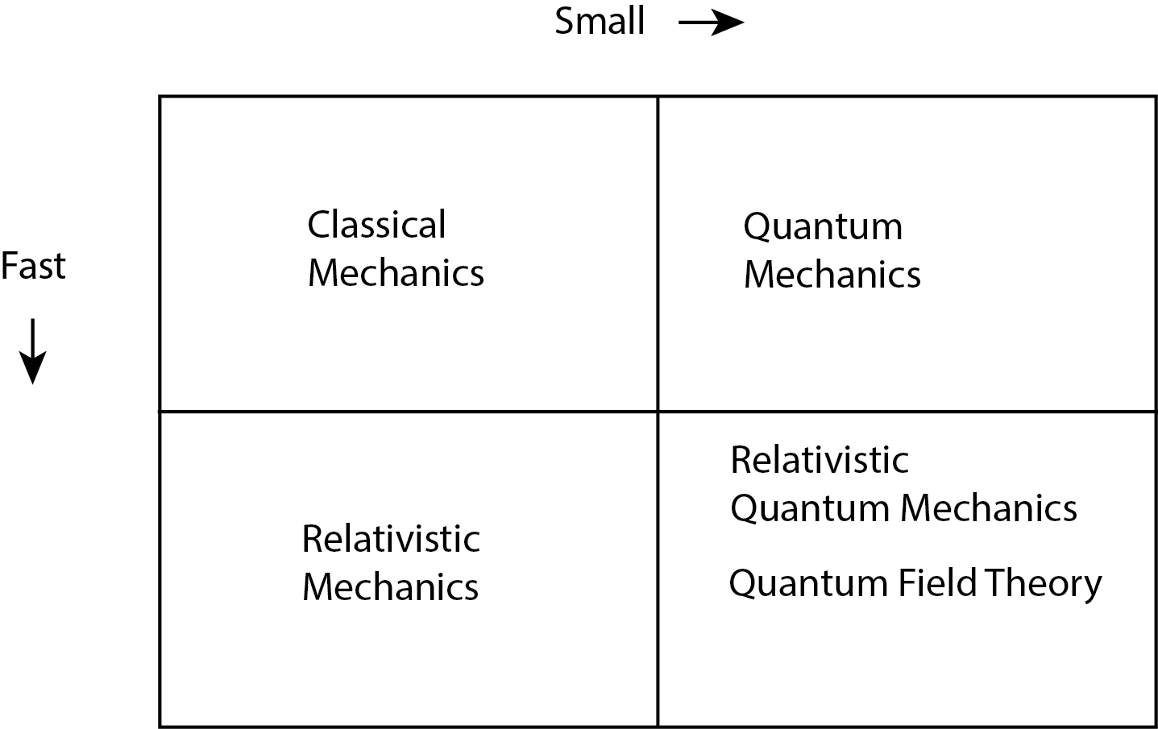
Introduction (cont’d)
The force law tells you what F is, and
the mechanics tells you how to use F to
determine the motion.
The Four Forces in Nature
Gravity
Electromagnetic
Weak
Strong
Antiparticles
CPT Theorem
Pauli Exclusion Principle

Slide 5
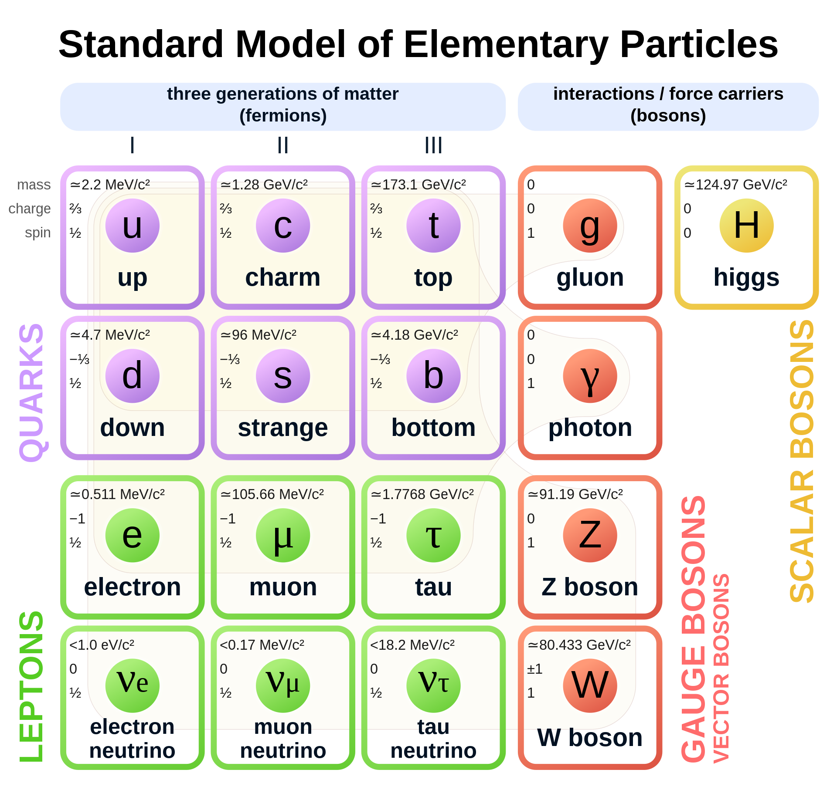
Introduction (cont’d)
The Standard Model 1. Quantum Electrodynamics (QED). Electromagnetic forces 2. Glashow-Weinberg-Salam theory of weak interactions (GWS). Weak forces 3. Quantum Chromodynamics. (QCD). Strong forces

